Slide 1
Visual Object Search
CMP3103M Autonomous Mobile Robotics
Mark Brewin (16607642)

Slide 2
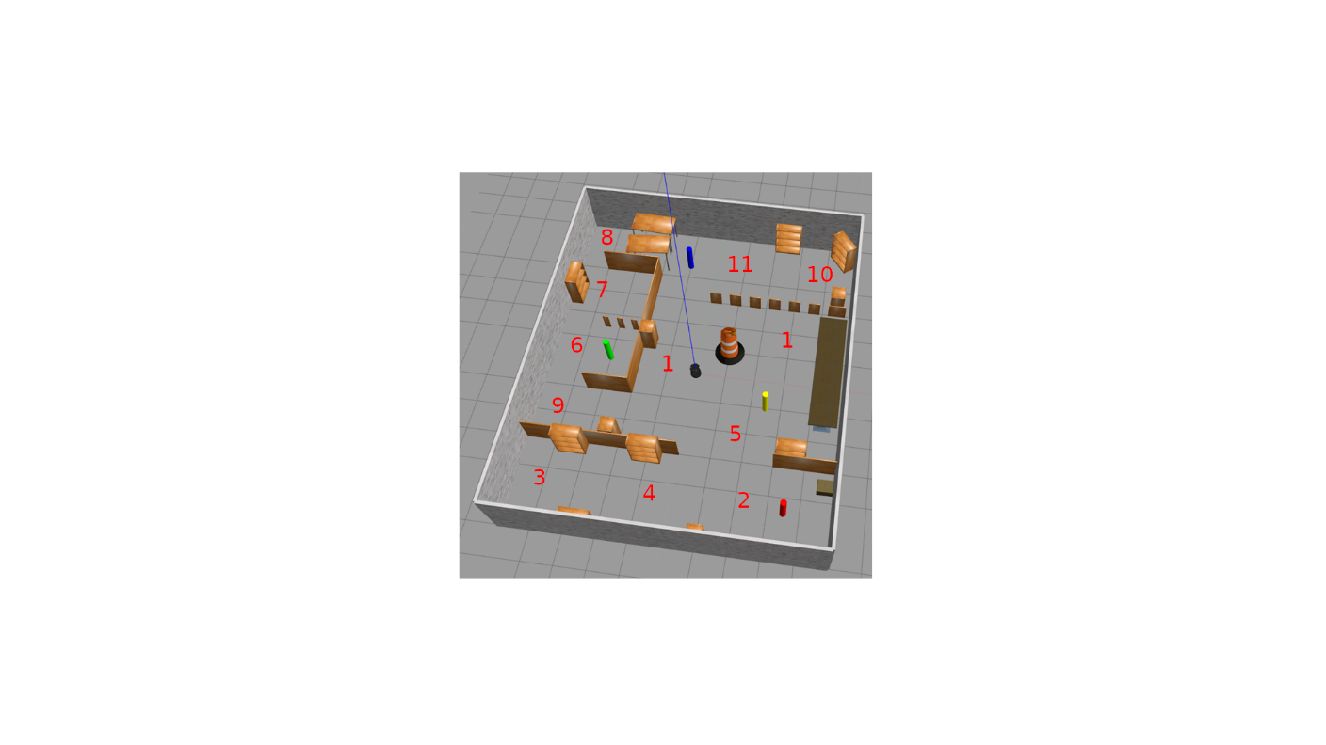
System Design
Waypoints are placed at different areas allowing the robot to navigate around the room using the global cost map and AMCL, creating a patrol.
As the robot navigates data retrieved from the RGB camera is processed using OpenCV to find the coloured objects using colour slicing.
Once a coloured object is seen by the robot, the current waypoint goal is cancelled, allowing for it to move towards the target object.
Data from the laser scanner is used to determine the distance of the object away from the robot.
Once the robot is less than a metre from the target the robot can mark it as successfully found before continuing with it’s patrol of the room.
After all objects have been located the robot can stop patrolling and searching the room.

Slide 3
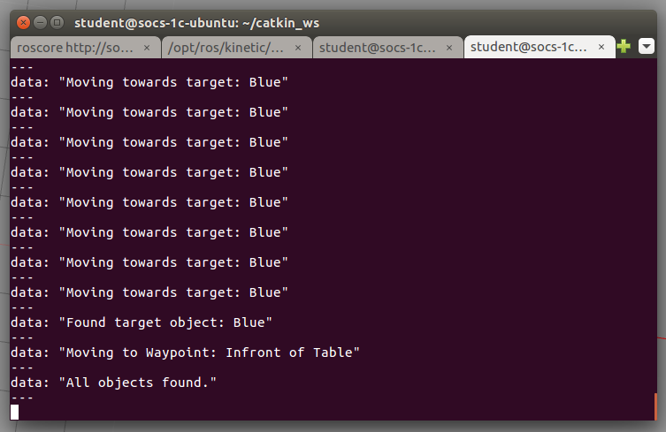
Results
The final program allows the robot to successfully find all objects within the test area.
Moving the objects to different locations within the area proved successful as well.
During development it was noted that target objects in the distance behind other objects gave false positives. To combat this the mask was changed to only allow objects to be detected within a smaller point of view.
Moving underneath the table also proved troublesome for the robot so an additional waypoint was provided to go around it instead.
Handling was also added in case access to a waypoint is blocked or the robot fails to locate a target object after initially seeing it.

